Slide 1
MOSFET + SUPPLY Testing
By: William Poole

Slide 2
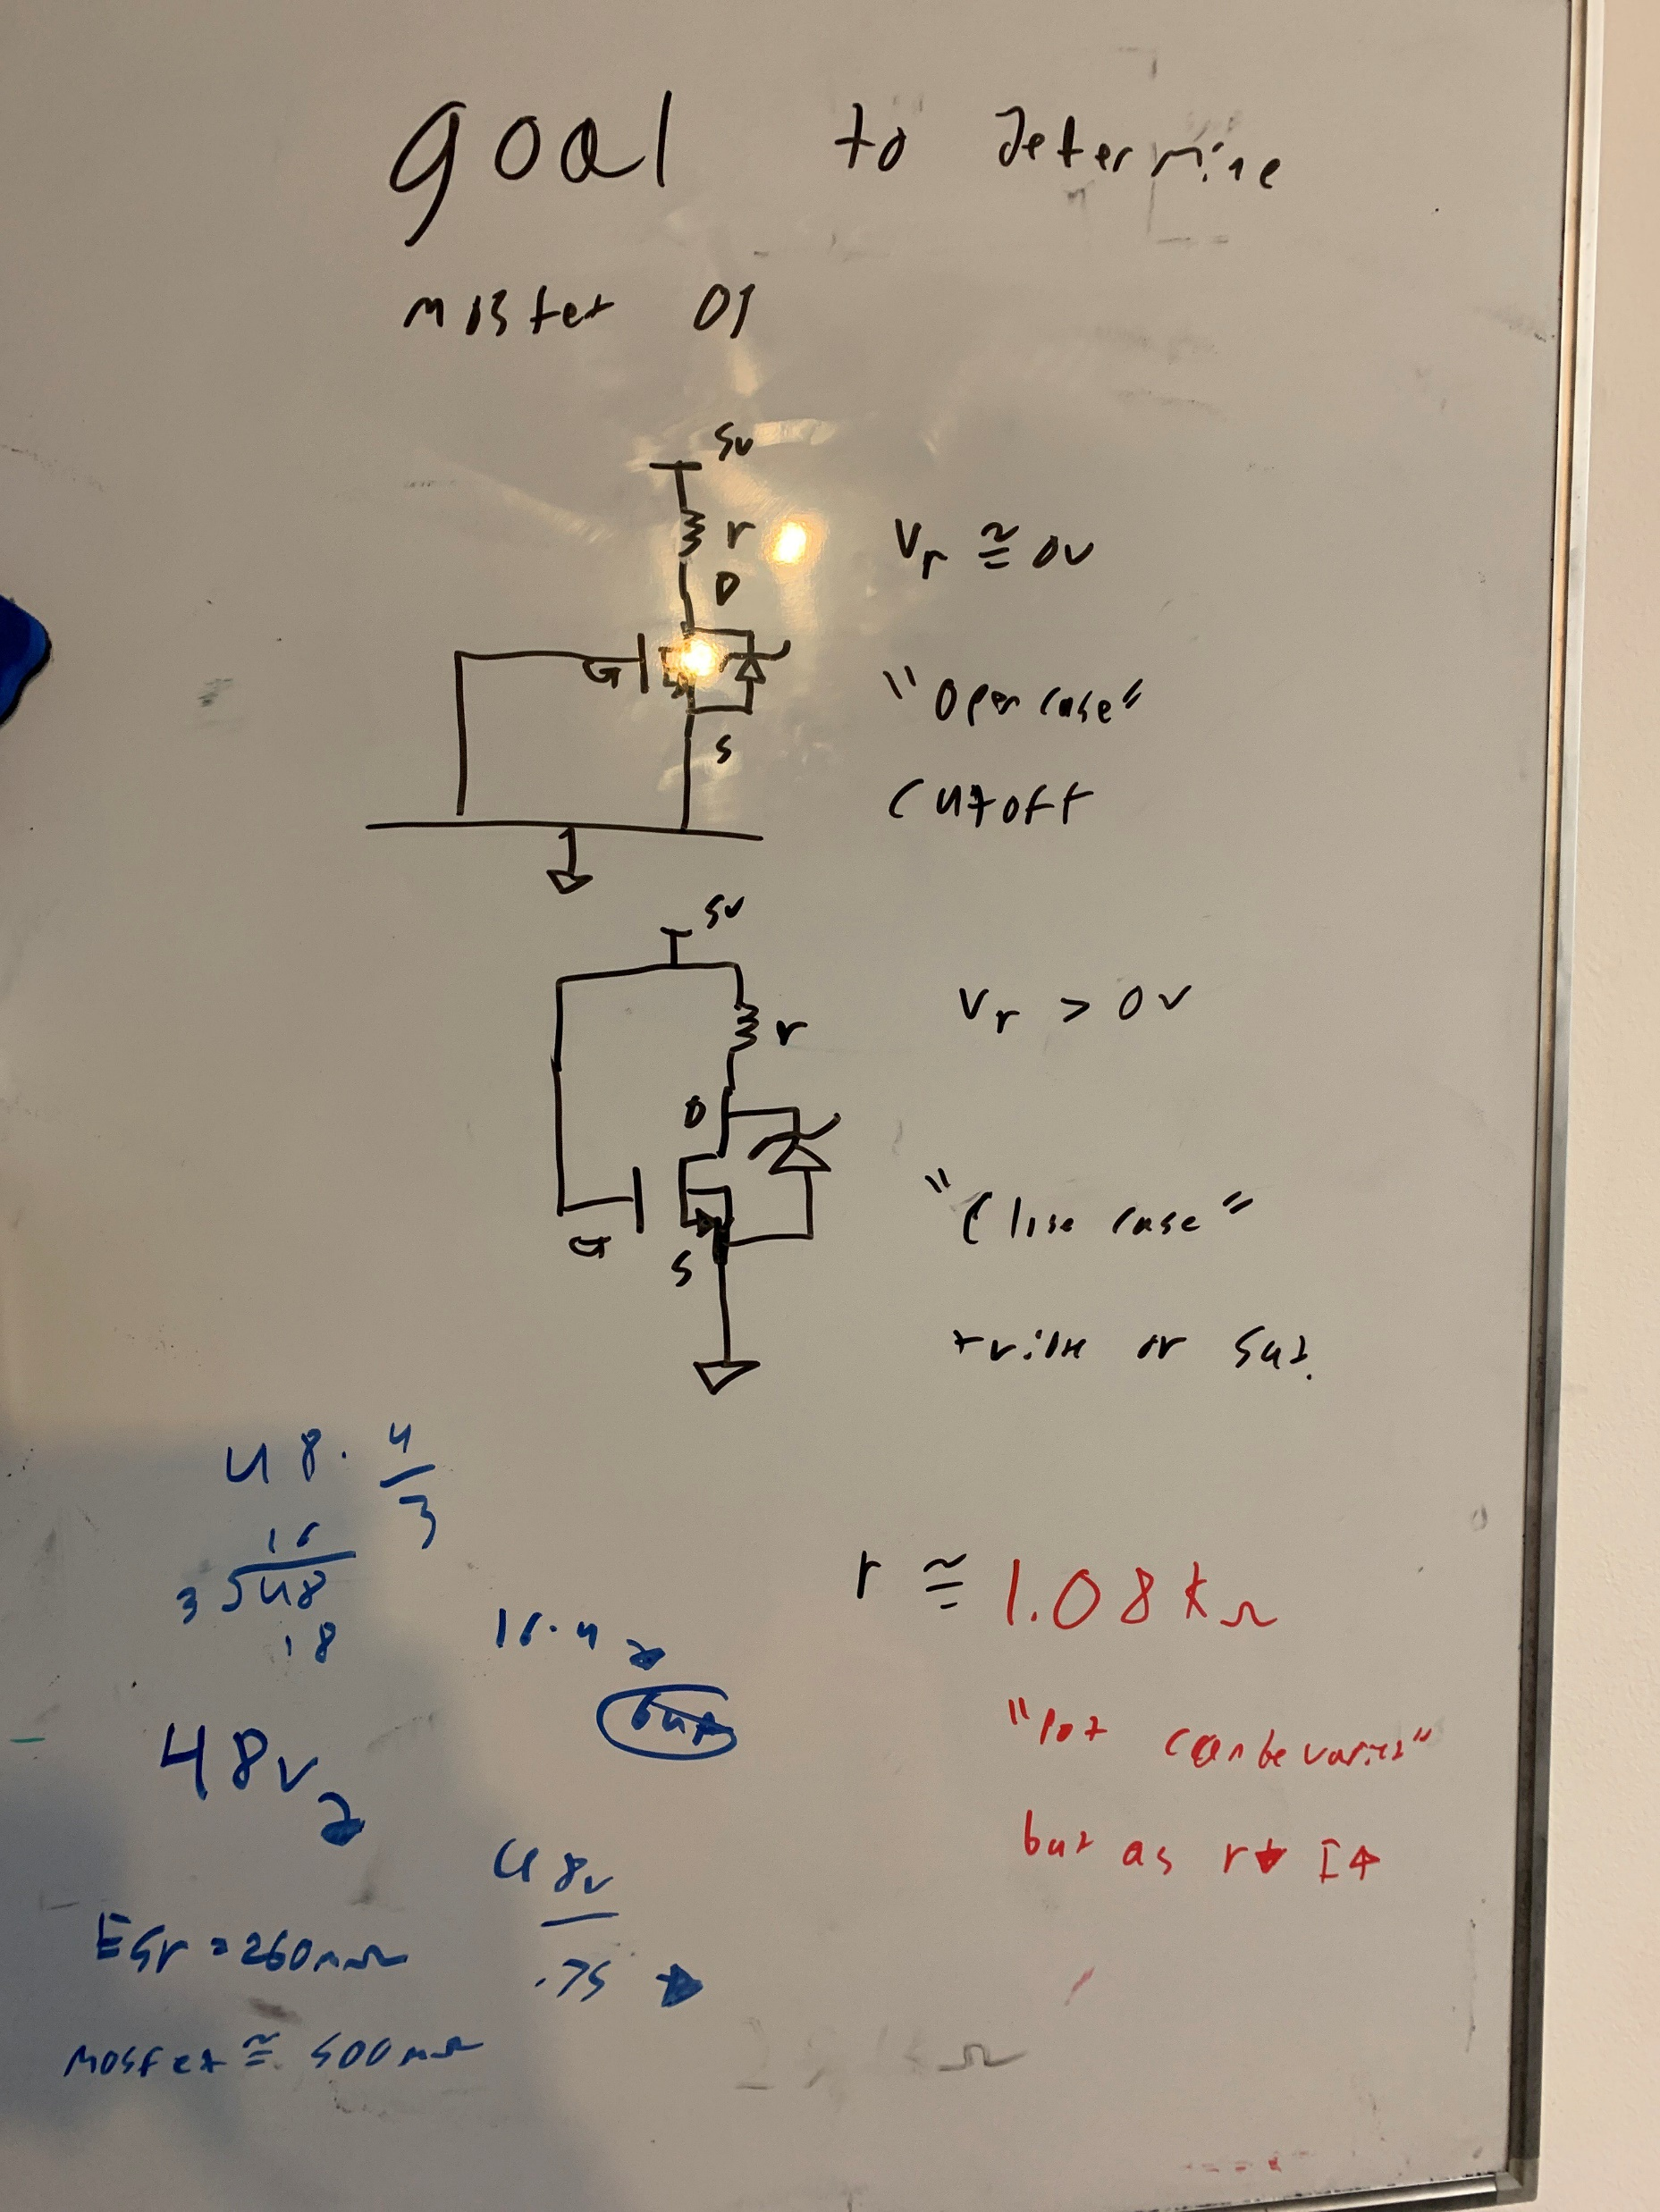
MOSFET Configuration
Observe MOSFET in what should be Cutoff and Saturation
System:
Gate: Voltage=0V {Cutoff} and 5V {Saturation}
Source: 0V ref
Drain: 5V through Pot 1k-ohm

Slide 3
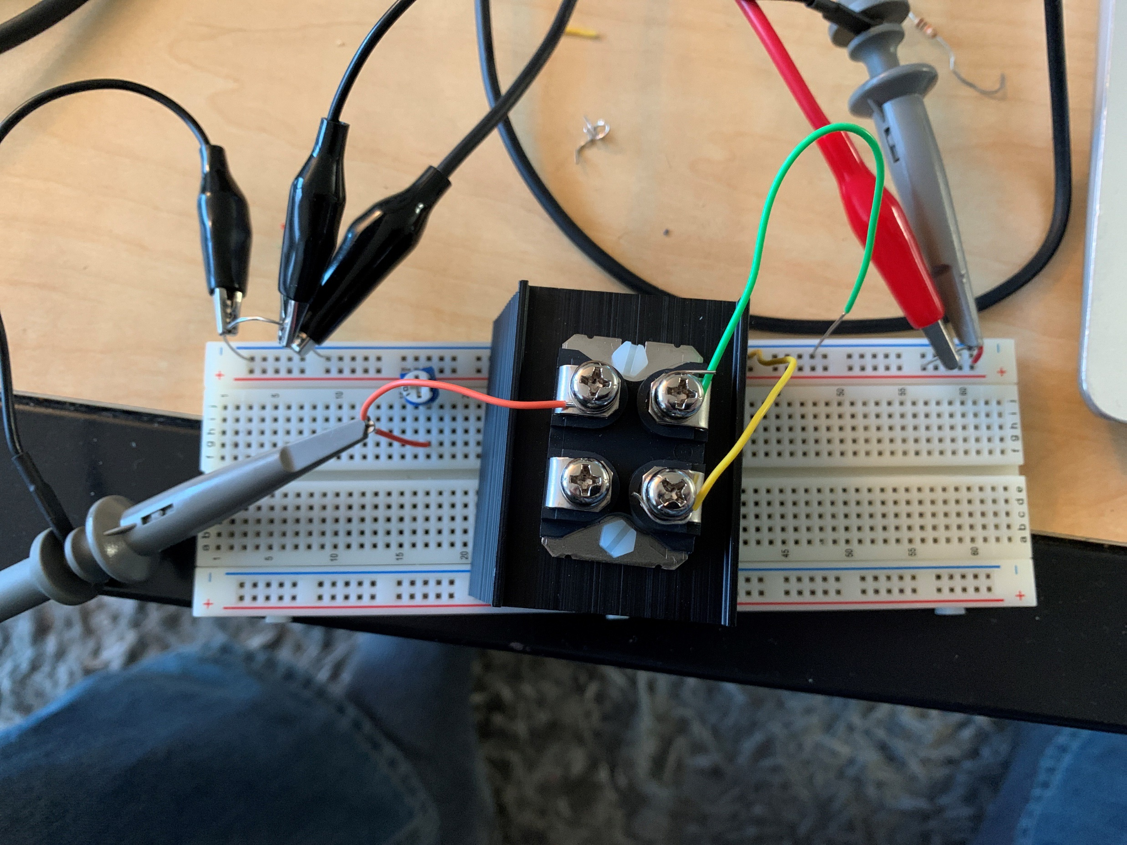
Picture of circuit
5V supply by diligent
Ch1 tied to 5V bus
Ch2 tied to Drain
Pot started at 1.08k

Slide 4
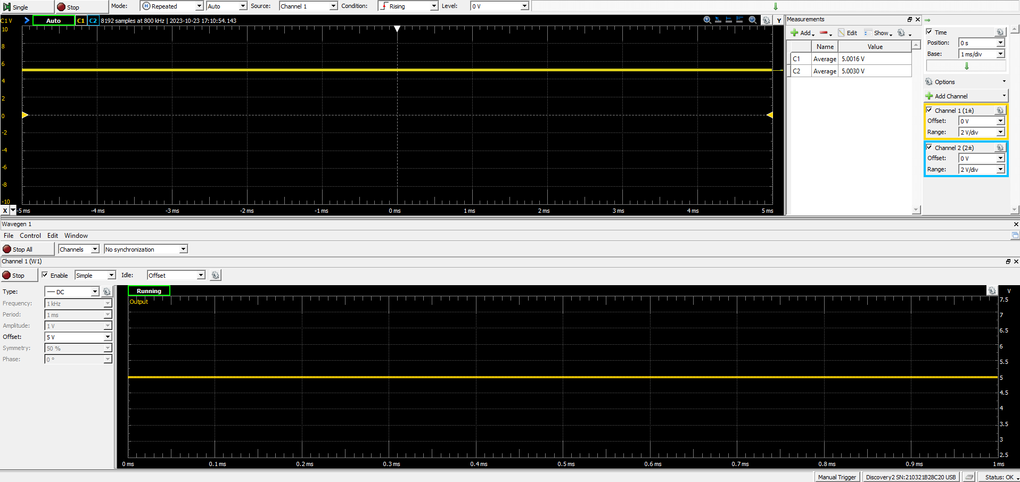
Gate Grounded, R=1k [Ch1=Ch2=5V] Cutoff

Slide 5
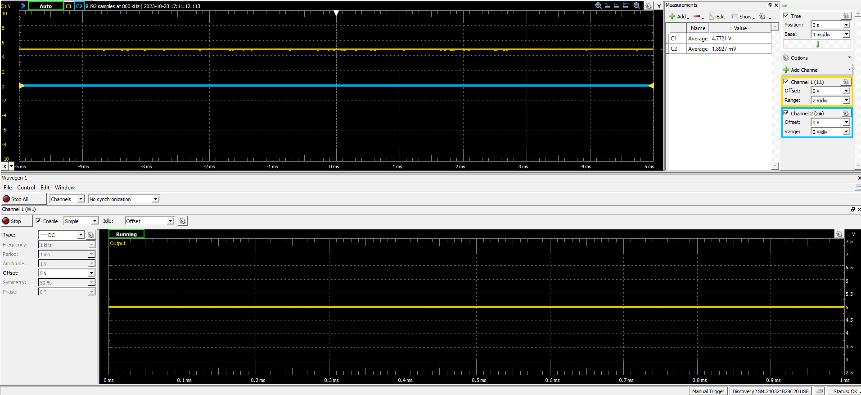
Gate 5V,R=1k [Ch1=4.7,Ch2=2mv,I=4.7mA] Sat

Slide 6
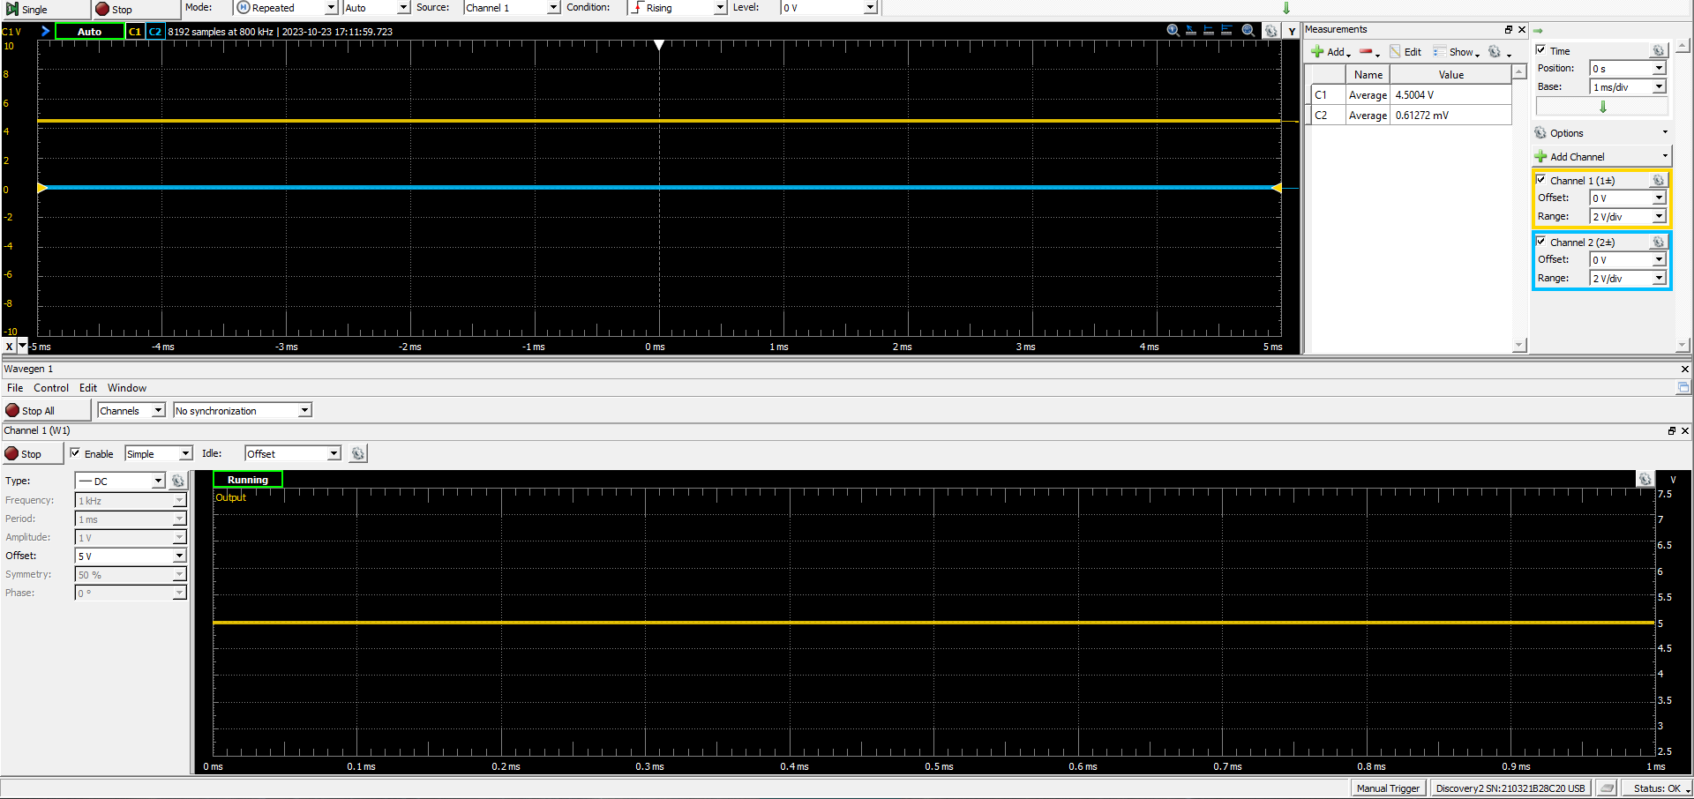
Gate 5V,R=0.5k [Ch1=4.5,Ch2=0.61v,I=7.8mA]

Slide 7
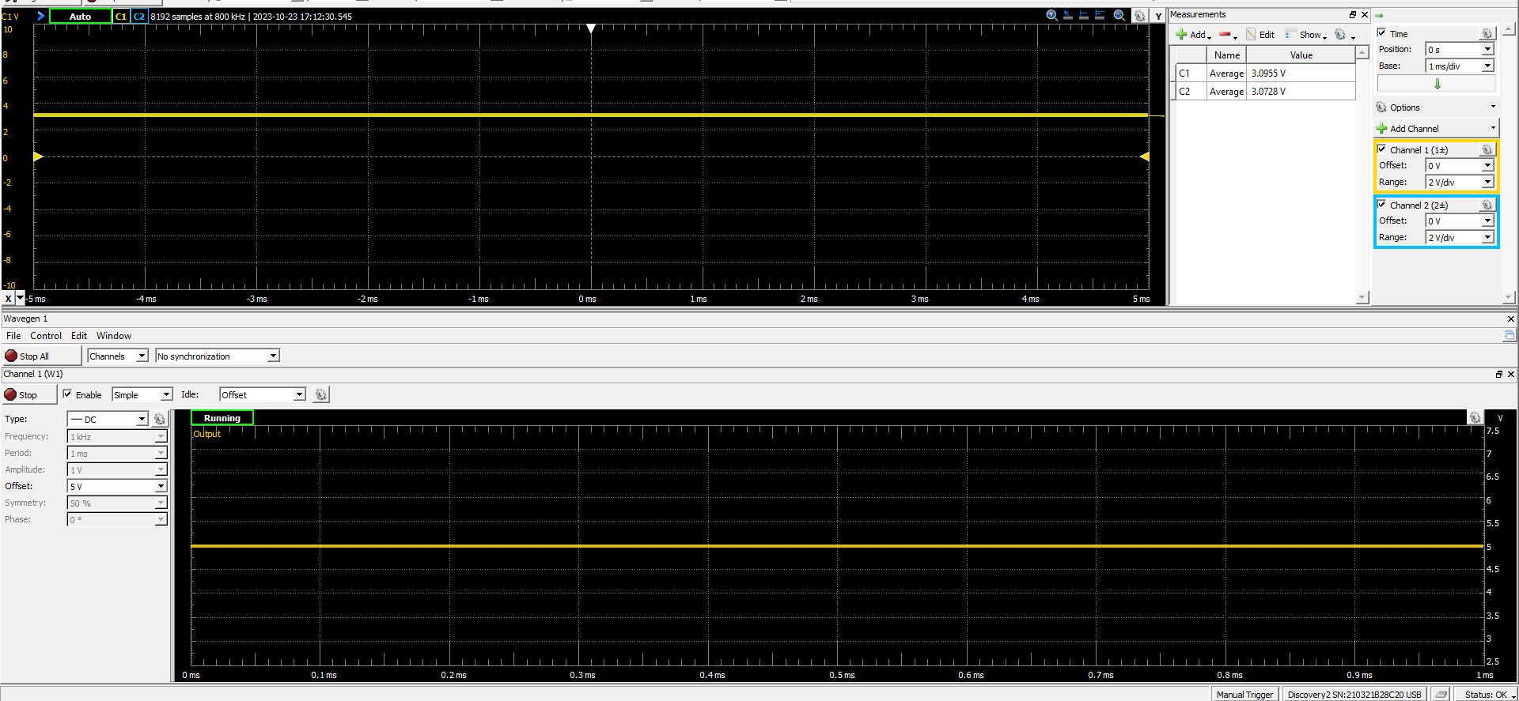
Gate =5V R~=0 [Ch1=Ch2=3.08V] Sat

Slide 8
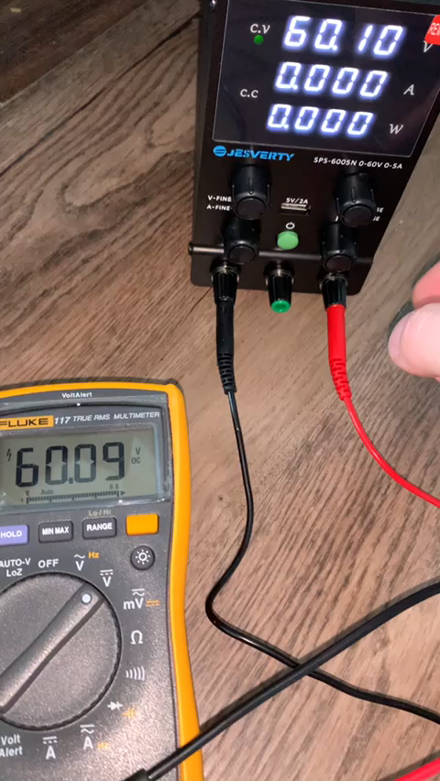
Power Supply Working
Voltage Working
Matches with Fluke 117

